Slide 1
DP common problems

Slide 2
Knapsack problem

Slide 3
Knapsack problem
The knapsack problem is a problem in combinatorial optimization.
Given a set of items, each with a weight and a value.
Determine the number of each item to include in a collection so that the total weight is less than or equal to a given limit and the total value is as large as possible.

Slide 4
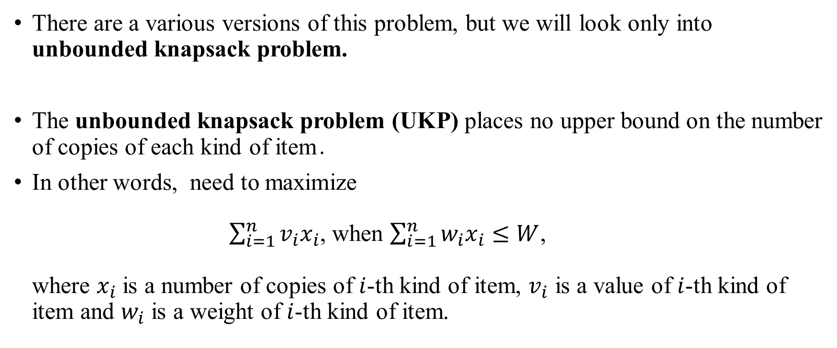
Knapsack problem
There are a various versions of this problem, but we will look only into unbounded knapsack problem.
The unbounded knapsack problem (UKP) places no upper bound on the number of copies of each kind of item․
In other words, need to maximize $\sum_{i=1}^{n}{v_{i}x_{i}}$, when $\sum_{i=1}^{n}{w_{i}x_{i}≤W}$, where $x_{i}$ is a number of copies of $i$-th kind of item, $v_{i}$ is a value of $i$-th kind of item and $w_{i}$ is a weight of $i$-th kind of item.

Slide 5
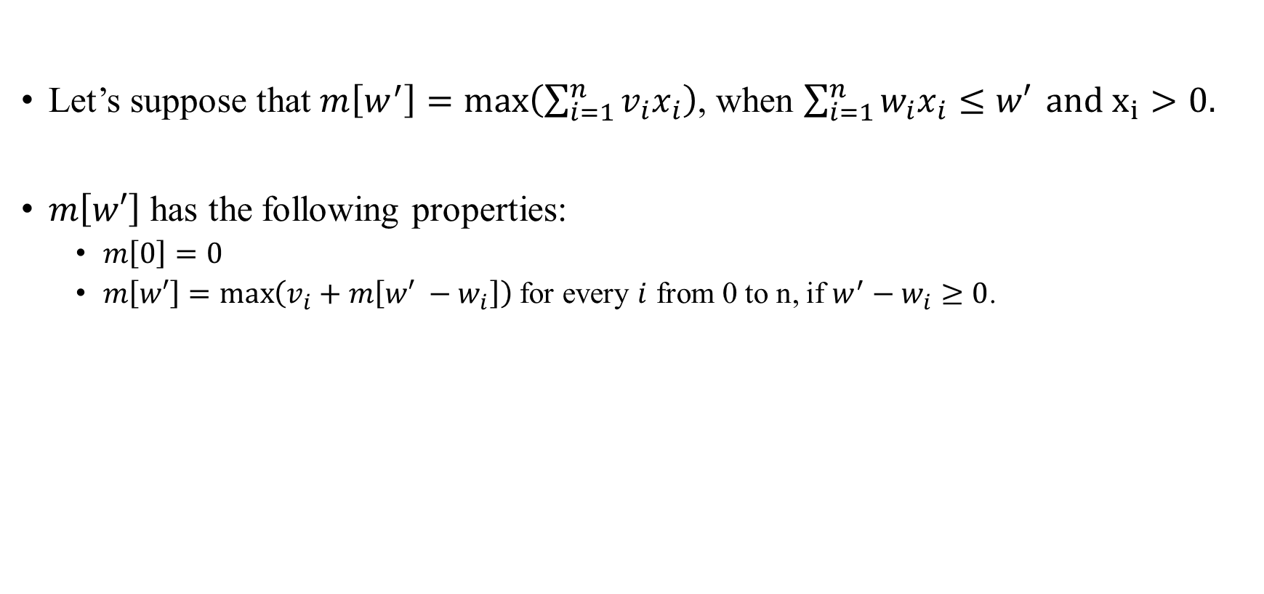
Knapsack problem Solution
Let’s suppose that $m\left[w^{′}\right]=\max\left(\sum_{i=1}^{n}{v_{i}x_{i}}\right)$, when $\sum_{i=1}^{n}{w_{i}x_{i}≤w′} and x_{i}>0.$
$m\left[w′\right]$ has the following properties:
$m\left[0\right]=0$
$m\left[w′\right]=\max\left(v_{i}+m\left[w′ −w_{i}\right]\right)$ for every $i$ from 0 to n, if $w^{′}−w_{i}≥0$.

Slide 6
Knapsack problem Solution
For example, there are items with the following weight: {1, 3, 4, 6, 9} kilos․
Each item have it’s own value: {1, 3, 5, 7, 3} golds․
And our knapsack can include 20 kilos.

Slide 7
Knapsack problem Solution
For example, there are items with the following weight: {1, 3, 4, 6, 9} kilos․
Each item have it’s own value: {1, 3, 5, 7, 3} golds․
And our knapsack can include 20 kilos.
Index | 0 | 1 | 2 | 3 | 4 | 5 | 6 | 7 | 8 | 9 | 10 | 11 | 12 | 13 | 14 | 15 | 16 | 17 | 18 | 19 | 20
Value

Slide 8

Knapsack problem Solution
For example, there are items with the following weight: {1, 3, 4, 6, 9} kilos․
Each item have it’s own value: {1, 3, 5, 7, 3} golds․
And our knapsack can include 20 kilos.
$m\left[0\right]$is always 0.
Index | 0 | 1 | 2 | 3 | 4 | 5 | 6 | 7 | 8 | 9 | 10 | 11 | 12 | 13 | 14 | 15 | 16 | 17 | 18 | 19 | 20
Value | 0

Slide 9
Knapsack problem Solution
For example, there are items with the following weight: {1, 3, 4, 6, 9} kilos․
Each item have it’s own value: {1, 3, 5, 7, 3} golds․
And our knapsack can include 20 kilos.
If weight of our knapsack is 1, we could add only item with weight 1.
Index | 0 | 1 | 2 | 3 | 4 | 5 | 6 | 7 | 8 | 9 | 10 | 11 | 12 | 13 | 14 | 15 | 16 | 17 | 18 | 19 | 20
Value | 0 | 1

Slide 10
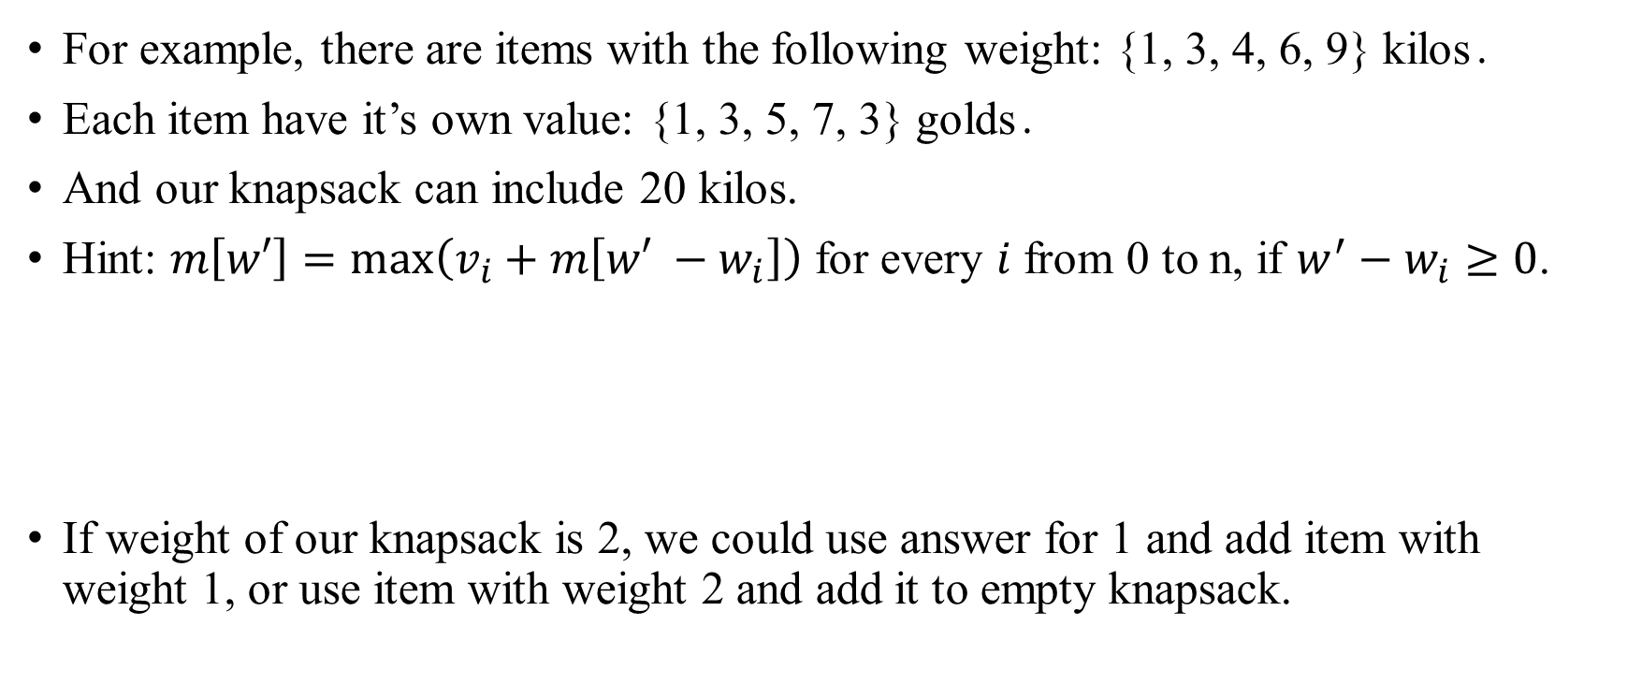
Knapsack problem Solution
For example, there are items with the following weight: {1, 3, 4, 6, 9} kilos․
Each item have it’s own value: {1, 3, 5, 7, 3} golds․
And our knapsack can include 20 kilos.
Hint: $m\left[w′\right]=\max\left(v_{i}+m\left[w′ −w_{i}\right]\right)$ for every $i$ from 0 to n, if $w^{′}−w_{i}≥0$.
If weight of our knapsack is 2, we could use answer for 1 and add item with weight 1, or use item with weight 2 and add it to empty knapsack.
Index | 0 | 1 | 2 | 3 | 4 | 5 | 6 | 7 | 8 | 9 | 10 | 11 | 12 | 13 | 14 | 15 | 16 | 17 | 18 | 19 | 20
Value | 0 | 1 | 2

Slide 11

Knapsack problem Solution
For example, there are items with the following weight: {1, 3, 4, 6, 9} kilos․
Each item have it’s own value: {1, 3, 5, 7, 3} golds․
And our knapsack can include 20 kilos.
Hint: $m\left[w′\right]=\max\left(v_{i}+m\left[w′ −w_{i}\right]\right)$ for every $i$ from 0 to n, if $w^{′}−w_{i}≥0$.
Index | 0 | 1 | 2 | 3 | 4 | 5 | 6 | 7 | 8 | 9 | 10 | 11 | 12 | 13 | 14 | 15 | 16 | 17 | 18 | 19 | 20
Value | 0 | 1 | 2 | 3

Slide 12
Knapsack problem Solution
For example, there are items with the following weight: {1, 3, 4, 6, 9} kilos․
Each item have it’s own value: {1, 3, 5, 7, 3} golds․
And our knapsack can include 20 kilos.
Hint: $m\left[w′\right]=\max\left(v_{i}+m\left[w′ −w_{i}\right]\right)$ for every $i$ from 0 to n, if $w^{′}−w_{i}≥0$.
Index | 0 | 1 | 2 | 3 | 4 | 5 | 6 | 7 | 8 | 9 | 10 | 11 | 12 | 13 | 14 | 15 | 16 | 17 | 18 | 19 | 20
Value | 0 | 1 | 2 | 3 | 5

Slide 13
Knapsack problem Solution
For example, there are items with the following weight: {1, 3, 4, 6, 9} kilos․
Each item have it’s own value: {1, 3, 5, 7, 3} golds․
And our knapsack can include 20 kilos.
Hint: $m\left[w′\right]=\max\left(v_{i}+m\left[w′ −w_{i}\right]\right)$ for every $i$ from 0 to n, if $w^{′}−w_{i}≥0$.
Index | 0 | 1 | 2 | 3 | 4 | 5 | 6 | 7 | 8 | 9 | 10 | 11 | 12 | 13 | 14 | 15 | 16 | 17 | 18 | 19 | 20
Value | 0 | 1 | 2 | 3 | 5 | 6

Slide 14
Knapsack problem Solution
For example, there are items with the following weight: {1, 3, 4, 6, 9} kilos․
Each item have it’s own value: {1, 3, 5, 7, 3} golds․
And our knapsack can include 20 kilos.
Hint: $m\left[w′\right]=\max\left(v_{i}+m\left[w′ −w_{i}\right]\right)$ for every $i$ from 0 to n, if $w^{′}−w_{i}≥0$.
Index | 0 | 1 | 2 | 3 | 4 | 5 | 6 | 7 | 8 | 9 | 10 | 11 | 12 | 13 | 14 | 15 | 16 | 17 | 18 | 19 | 20
Value | 0 | 1 | 2 | 3 | 5 | 6 | 7

Slide 15
Knapsack problem Solution
For example, there are items with the following weight: {1, 3, 4, 6, 9} kilos․
Each item have it’s own value: {1, 3, 5, 7, 3} golds․
And our knapsack can include 20 kilos.
Hint: $m\left[w′\right]=\max\left(v_{i}+m\left[w′ −w_{i}\right]\right)$ for every $i$ from 0 to n, if $w^{′}−w_{i}≥0$.
Index | 0 | 1 | 2 | 3 | 4 | 5 | 6 | 7 | 8 | 9 | 10 | 11 | 12 | 13 | 14 | 15 | 16 | 17 | 18 | 19 | 20
Value | 0 | 1 | 2 | 3 | 5 | 6 | 7 | 8

Slide 16
Knapsack problem Solution
For example, there are items with the following weight: {1, 3, 4, 6, 9} kilos․
Each item have it’s own value: {1, 3, 5, 7, 3} golds․
And our knapsack can include 20 kilos.
Hint: $m\left[w′\right]=\max\left(v_{i}+m\left[w′ −w_{i}\right]\right)$ for every $i$ from 0 to n, if $w^{′}−w_{i}≥0$.
Index | 0 | 1 | 2 | 3 | 4 | 5 | 6 | 7 | 8 | 9 | 10 | 11 | 12 | 13 | 14 | 15 | 16 | 17 | 18 | 19 | 20
Value | 0 | 1 | 2 | 3 | 5 | 6 | 7 | 8 | 10

Slide 17
Knapsack problem Solution
For example, there are items with the following weight: {1, 3, 4, 6, 9} kilos․
Each item have it’s own value: {1, 3, 5, 7, 3} golds․
And our knapsack can include 20 kilos.
Hint: $m\left[w′\right]=\max\left(v_{i}+m\left[w′ −w_{i}\right]\right)$ for every $i$ from 0 to n, if $w^{′}−w_{i}≥0$.
Index | 0 | 1 | 2 | 3 | 4 | 5 | 6 | 7 | 8 | 9 | 10 | 11 | 12 | 13 | 14 | 15 | 16 | 17 | 18 | 19 | 20
Value | 0 | 1 | 2 | 3 | 5 | 6 | 7 | 8 | 10 | 11

Slide 18
Knapsack problem Solution
For example, there are items with the following weight: {1, 3, 4, 6, 9} kilos․
Each item have it’s own value: {1, 3, 5, 7, 3} golds․
And our knapsack can include 20 kilos.
Hint: $m\left[w′\right]=\max\left(v_{i}+m\left[w′ −w_{i}\right]\right)$ for every $i$ from 0 to n, if $w^{′}−w_{i}≥0$.
Index | 0 | 1 | 2 | 3 | 4 | 5 | 6 | 7 | 8 | 9 | 10 | 11 | 12 | 13 | 14 | 15 | 16 | 17 | 18 | 19 | 20
Value | 0 | 1 | 2 | 3 | 5 | 6 | 7 | 8 | 10 | 11 | 12

Slide 19
Knapsack problem Solution
For example, there are items with the following weight: {1, 3, 4, 6, 9} kilos․
Each item have it’s own value: {1, 3, 5, 7, 3} golds․
And our knapsack can include 20 kilos.
Hint: $m\left[w′\right]=\max\left(v_{i}+m\left[w′ −w_{i}\right]\right)$ for every $i$ from 0 to n, if $w^{′}−w_{i}≥0$.
Index | 0 | 1 | 2 | 3 | 4 | 5 | 6 | 7 | 8 | 9 | 10 | 11 | 12 | 13 | 14 | 15 | 16 | 17 | 18 | 19 | 20
Value | 0 | 1 | 2 | 3 | 5 | 6 | 7 | 8 | 10 | 11 | 12 | 13

Slide 20
Knapsack problem Solution
For example, there are items with the following weight: {1, 3, 4, 6, 9} kilos․
Each item have it’s own value: {1, 3, 5, 7, 3} golds․
And our knapsack can include 20 kilos.
Hint: $m\left[w′\right]=\max\left(v_{i}+m\left[w′ −w_{i}\right]\right)$ for every $i$ from 0 to n, if $w^{′}−w_{i}≥0$.
Index | 0 | 1 | 2 | 3 | 4 | 5 | 6 | 7 | 8 | 9 | 10 | 11 | 12 | 13 | 14 | 15 | 16 | 17 | 18 | 19 | 20
Value | 0 | 1 | 2 | 3 | 5 | 6 | 7 | 8 | 10 | 11 | 12 | 13 | 15

Slide 21
Knapsack problem Solution
For example, there are items with the following weight: {1, 3, 4, 6, 9} kilos․
Each item have it’s own value: {1, 3, 5, 7, 3} golds․
And our knapsack can include 20 kilos.
Hint: $m\left[w′\right]=\max\left(v_{i}+m\left[w′ −w_{i}\right]\right)$ for every $i$ from 0 to n, if $w^{′}−w_{i}≥0$.
Index | 0 | 1 | 2 | 3 | 4 | 5 | 6 | 7 | 8 | 9 | 10 | 11 | 12 | 13 | 14 | 15 | 16 | 17 | 18 | 19 | 20
Value | 0 | 1 | 2 | 3 | 5 | 6 | 7 | 8 | 10 | 11 | 12 | 13 | 15 | 16

Slide 22
Knapsack problem Solution
For example, there are items with the following weight: {1, 3, 4, 6, 9} kilos․
Each item have it’s own value: {1, 3, 5, 7, 3} golds․
And our knapsack can include 20 kilos.
Hint: $m\left[w′\right]=\max\left(v_{i}+m\left[w′ −w_{i}\right]\right)$ for every $i$ from 0 to n, if $w^{′}−w_{i}≥0$.
Index | 0 | 1 | 2 | 3 | 4 | 5 | 6 | 7 | 8 | 9 | 10 | 11 | 12 | 13 | 14 | 15 | 16 | 17 | 18 | 19 | 20
Value | 0 | 1 | 2 | 3 | 5 | 6 | 7 | 8 | 10 | 11 | 12 | 13 | 15 | 16 | 17

Slide 23
Knapsack problem Solution
For example, there are items with the following weight: {1, 3, 4, 6, 9} kilos․
Each item have it’s own value: {1, 3, 5, 7, 3} golds․
And our knapsack can include 20 kilos.
Hint: $m\left[w′\right]=\max\left(v_{i}+m\left[w′ −w_{i}\right]\right)$ for every $i$ from 0 to n, if $w^{′}−w_{i}≥0$.
Index | 0 | 1 | 2 | 3 | 4 | 5 | 6 | 7 | 8 | 9 | 10 | 11 | 12 | 13 | 14 | 15 | 16 | 17 | 18 | 19 | 20
Value | 0 | 1 | 2 | 3 | 5 | 6 | 7 | 8 | 10 | 11 | 12 | 13 | 15 | 16 | 17 | 18

Slide 24
Knapsack problem Solution
For example, there are items with the following weight: {1, 3, 4, 6, 9} kilos․
Each item have it’s own value: {1, 3, 5, 7, 3} golds․
And our knapsack can include 20 kilos.
Hint: $m\left[w′\right]=\max\left(v_{i}+m\left[w′ −w_{i}\right]\right)$ for every $i$ from 0 to n, if $w^{′}−w_{i}≥0$.
Index | 0 | 1 | 2 | 3 | 4 | 5 | 6 | 7 | 8 | 9 | 10 | 11 | 12 | 13 | 14 | 15 | 16 | 17 | 18 | 19 | 20
Value | 0 | 1 | 2 | 3 | 5 | 6 | 7 | 8 | 10 | 11 | 12 | 13 | 15 | 16 | 17 | 18 | 20

Slide 25
Knapsack problem Solution
For example, there are items with the following weight: {1, 3, 4, 6, 9} kilos․
Each item have it’s own value: {1, 3, 5, 7, 3} golds․
And our knapsack can include 20 kilos.
Hint: $m\left[w′\right]=\max\left(v_{i}+m\left[w′ −w_{i}\right]\right)$ for every $i$ from 0 to n, if $w^{′}−w_{i}≥0$.
Index | 0 | 1 | 2 | 3 | 4 | 5 | 6 | 7 | 8 | 9 | 10 | 11 | 12 | 13 | 14 | 15 | 16 | 17 | 18 | 19 | 20
Value | 0 | 1 | 2 | 3 | 5 | 6 | 7 | 8 | 10 | 11 | 12 | 13 | 15 | 16 | 17 | 18 | 20 | 21

Slide 26
Knapsack problem Solution
For example, there are items with the following weight: {1, 3, 4, 6, 9} kilos․
Each item have it’s own value: {1, 3, 5, 7, 3} golds․
And our knapsack can include 20 kilos.
Hint: $m\left[w′\right]=\max\left(v_{i}+m\left[w′ −w_{i}\right]\right)$ for every $i$ from 0 to n, if $w^{′}−w_{i}≥0$.
Index | 0 | 1 | 2 | 3 | 4 | 5 | 6 | 7 | 8 | 9 | 10 | 11 | 12 | 13 | 14 | 15 | 16 | 17 | 18 | 19 | 20
Value | 0 | 1 | 2 | 3 | 5 | 6 | 7 | 8 | 10 | 11 | 12 | 13 | 15 | 16 | 17 | 18 | 20 | 21 | 22

Slide 27
Knapsack problem Solution
For example, there are items with the following weight: {1, 3, 4, 6, 9} kilos․
Each item have it’s own value: {1, 3, 5, 7, 3} golds․
And our knapsack can include 20 kilos.
Hint: $m\left[w′\right]=\max\left(v_{i}+m\left[w′ −w_{i}\right]\right)$ for every $i$ from 0 to n, if $w^{′}−w_{i}≥0$.
Index | 0 | 1 | 2 | 3 | 4 | 5 | 6 | 7 | 8 | 9 | 10 | 11 | 12 | 13 | 14 | 15 | 16 | 17 | 18 | 19 | 20
Value | 0 | 1 | 2 | 3 | 5 | 6 | 7 | 8 | 10 | 11 | 12 | 13 | 15 | 16 | 17 | 18 | 20 | 21 | 22 | 23

Slide 28
Knapsack problem Solution
For example, there are items with the following weight: {1, 3, 4, 6, 9} kilos․
Each item have it’s own value: {1, 3, 5, 7, 3} golds․
And our knapsack can include 20 kilos.
Hint: $m\left[w′\right]=\max\left(v_{i}+m\left[w′ −w_{i}\right]\right)$ for every $i$ from 0 to n, if $w^{′}−w_{i}≥0$.
Index | 0 | 1 | 2 | 3 | 4 | 5 | 6 | 7 | 8 | 9 | 10 | 11 | 12 | 13 | 14 | 15 | 16 | 17 | 18 | 19 | 20
Value | 0 | 1 | 2 | 3 | 5 | 6 | 7 | 8 | 10 | 11 | 12 | 13 | 15 | 16 | 17 | 18 | 20 | 21 | 22 | 23 | 25

Slide 29
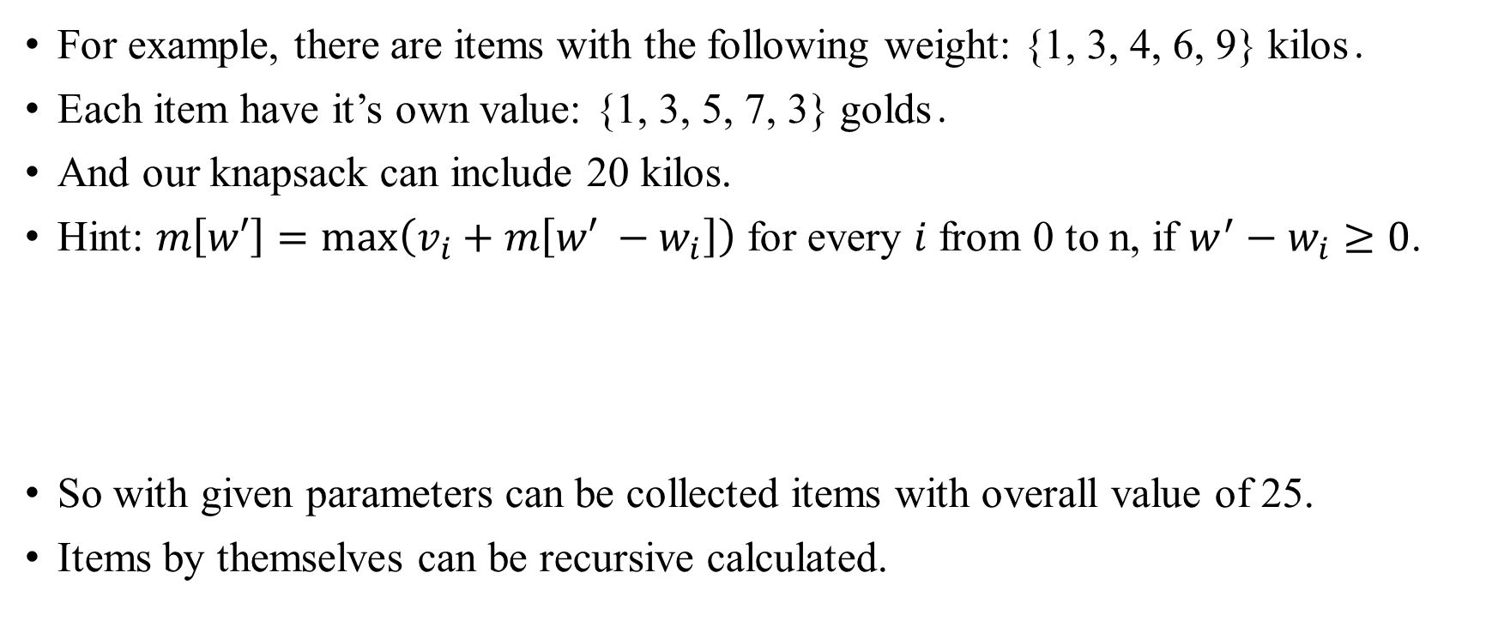
Knapsack problem Solution
For example, there are items with the following weight: {1, 3, 4, 6, 9} kilos․
Each item have it’s own value: {1, 3, 5, 7, 3} golds․
And our knapsack can include 20 kilos.
Hint: $m\left[w′\right]=\max\left(v_{i}+m\left[w′ −w_{i}\right]\right)$ for every $i$ from 0 to n, if $w^{′}−w_{i}≥0$.
So with given parameters can be collected items with overall value of 25.
Items by themselves can be recursive calculated.
Index | 0 | 1 | 2 | 3 | 4 | 5 | 6 | 7 | 8 | 9 | 10 | 11 | 12 | 13 | 14 | 15 | 16 | 17 | 18 | 19 | 20
Value | 0 | 1 | 2 | 3 | 5 | 6 | 7 | 8 | 10 | 11 | 12 | 13 | 15 | 16 | 17 | 18 | 20 | 21 | 22 | 23 | 25

Slide 30
Matrix multiplication problem

Slide 31
Matrix multiplication problem
Matrix chain multiplication is an optimization problem that can be solved using dynamic programming.
Given a sequence of matrices, the goal is to find the most efficient way to multiply these matrices․
The problem is not actually to perform the multiplications, but merely to decide the sequence of the matrix multiplications involved.

Slide 32
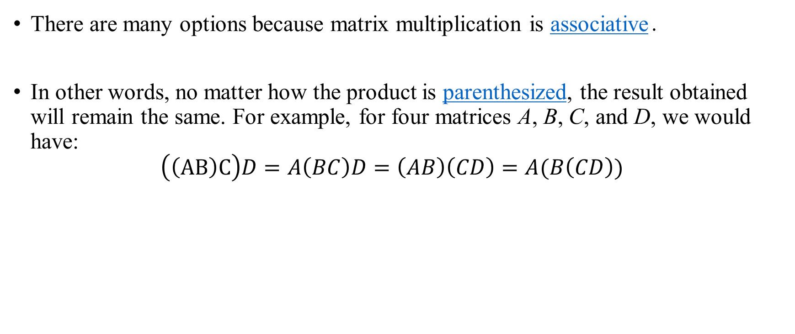
Matrix multiplication problem
There are many options because matrix multiplication is associative․
In other words, no matter how the product is parenthesized, the result obtained will remain the same. For example, for four matrices A, B, C, and D, we would have: $\left(\left(AB\right)C\right)D=A\left(BC\right)D=\left(AB\right)\left(CD\right)=A(B\left(CD\right))$

Slide 33
Matrix multiplication problem
However, the order in which the product is parenthesized affects the number of simple arithmetic operations needed to compute the product, that is the computational complexity. For example, if A is a 10 × 30 matrix, B is a 30 × 5 matrix, and C is a 5 × 60 matrix, then
computing (AB)C needs (10×30×5) + (10×5×60) = 1500 + 3000 = 4500 operations, while
computing A(BC) needs (30×5×60) + (10×30×60) = 9000 + 18000 = 27000 operations.
The first method is more efficient.
So with this information, the problem statement can be refined as "how to determine the optimal parenthesization of a product of n matrices?"

Slide 34
Matrix multiplication problem Solution
If we are only multiplying two matrices, there is only one way to multiply them, so the minimum cost is the cost of doing this.
In general, we can find the minimum cost using the following recursive algorithm:
Take the sequence of matrices and separate it into two subsequences.
Find the minimum cost of multiplying out each subsequence.
Add these costs together, and add in the cost of multiplying the two result matrices.
Do this for each possible position at which the sequence of matrices can be split, and take the minimum over all of them.
For example, if we have four matrices ABCD, we compute the cost required to find each of (A)(BCD), (AB)(CD), and (ABC)(D), making recursive calls to find the minimum cost to compute ABC, AB, CD, and BCD. We then choose the best one.

Slide 35
Matrix multiplication problem Solution
However, if we implement this algorithm we discover that it is just as slow as the naive way of trying all permutations․
The lack in logic is that we're doing a lot of redundant work.
For example, we made a recursive call to find the best cost for computing both ABC and AB. But finding the best cost for computing ABC also requires finding the best cost for AB. As the recursion grows deeper, more and more of this type of unnecessary repetition occurs.

Slide 36
Matrix multiplication problem Solution
One simple solution is called memoization.
Each time we compute the minimum cost needed to multiply out a specific subsequence, we save it.
If we are ever asked to compute it again, we simply give the saved answer, and do not recompute it.
It can be shown that this simple trick brings the runtime down to O(n³) from O(2^{n}), which is more than efficient enough for real applications.

Slide 37
Longest Increasing Subsequence

Slide 38
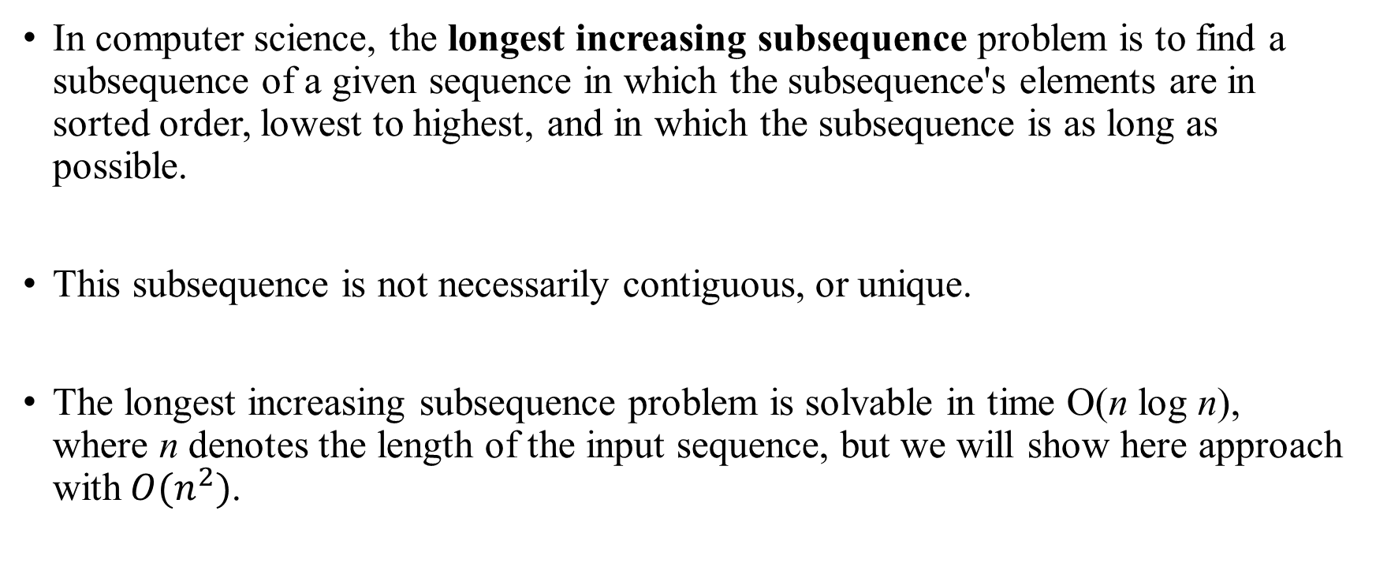
Longest Increasing Subsequence
In computer science, the longest increasing subsequence problem is to find a subsequence of a given sequence in which the subsequence's elements are in sorted order, lowest to highest, and in which the subsequence is as long as possible.
This subsequence is not necessarily contiguous, or unique.
The longest increasing subsequence problem is solvable in time O(n log n), where n denotes the length of the input sequence, but we will show here approach with$O(n^{2})$.

Slide 39
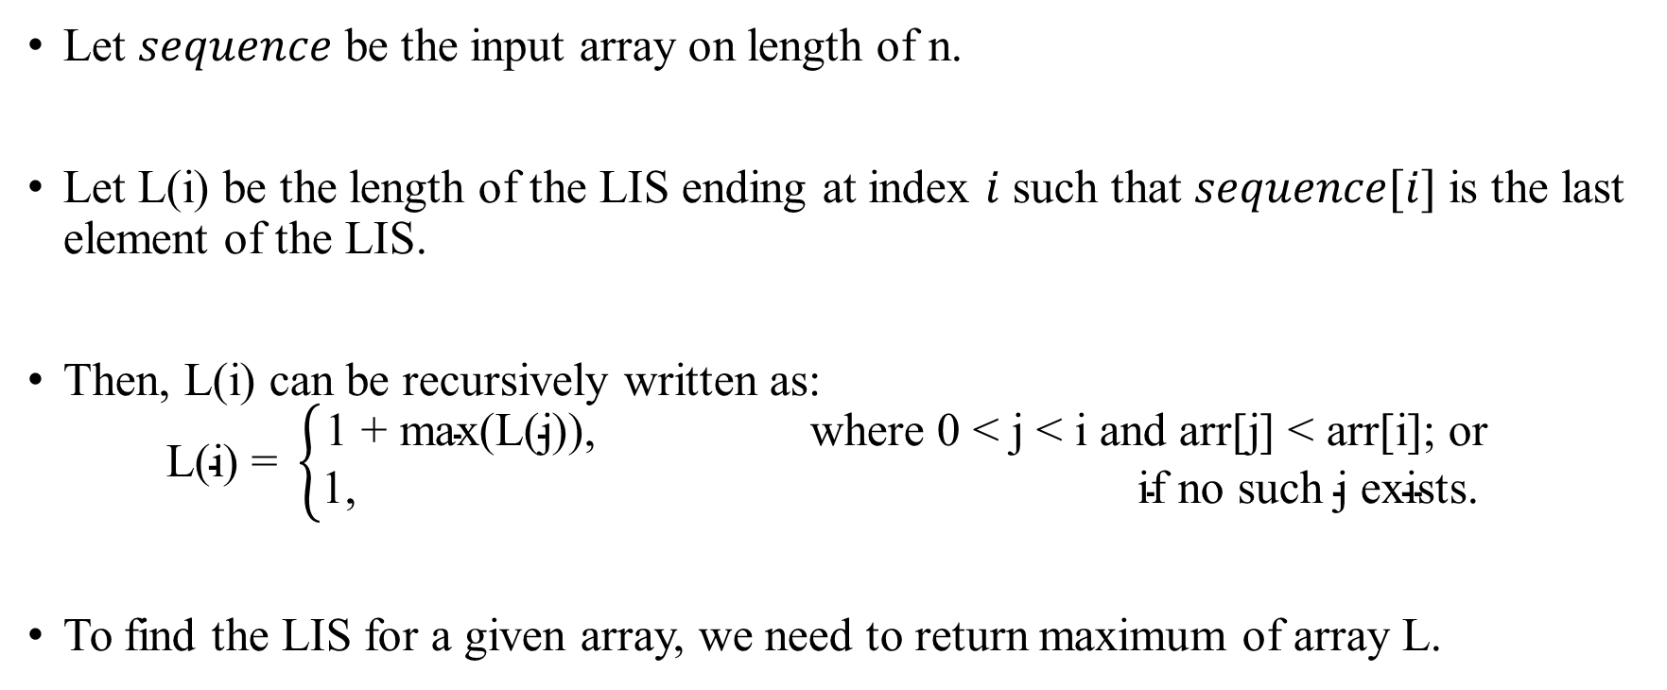
Longest Increasing Subsequence Algorithm
Let $sequence$ be the input array on length of n.
Let L(i) be the length of the LIS ending at index $i$ such that $sequence[i]$is the last element of the LIS.
Then, L(i) can be recursively written as:
$$\text{L}\text{(}\text{i}\text{) = }\left\{\begin{aligned}\text{1 + }\text{max}\text{(}\text{L}\text{(}\text{j}\text{)), }\text{where}\text{ 0 < }\text{j}\text{ < }\text{i} \text{and} \text{arr}\text{[}\text{j}\text{] < }\text{arr}\text{[}\text{i}\text{]; }\text{or} \\ \text{1, } \text{if} \text{no} \text{such} \text{j} \text{exists}\text{. }\end{aligned}\right.$$
To find the LIS for a given array, we need to return maximum of array L.

Slide 40
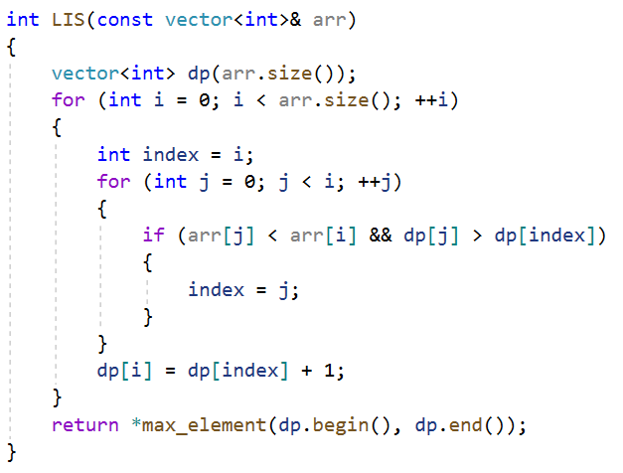
Longest Increasing Subsequence Implementation

Slide 41

Longest Increasing Subsequence Sequence reconstruction
For reconstruction we need to store “parent” array:

Slide 42
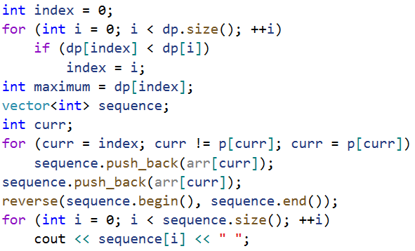
Longest Increasing Subsequence Sequence reconstruction
And after that we can print the sequence as follows:

Slide 43
Longest Common Subsequence

Slide 44
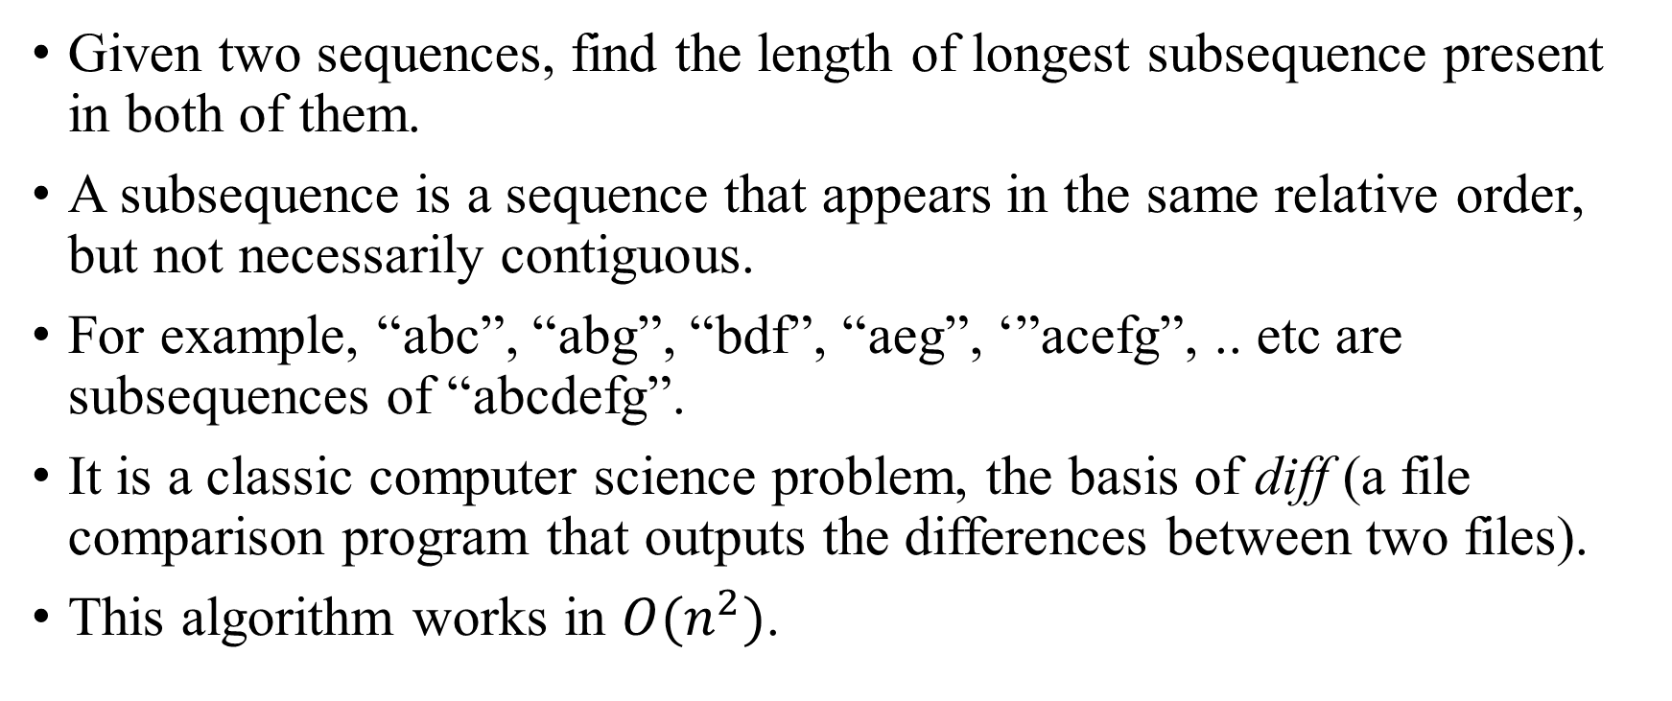
Longest Common Subsequence
Given two sequences, find the length of longest subsequence present in both of them.
A subsequence is a sequence that appears in the same relative order, but not necessarily contiguous.
For example, “abc”, “abg”, “bdf”, “aeg”, ‘”acefg”, .. etc are subsequences of “abcdefg”.
It is a classic computer science problem, the basis of diff (a file comparison program that outputs the differences between two files).
This algorithm works in $O(n^{2})$.

Slide 45
Longest Common Subsequence Examples
LCS for input Sequences “ABCDGH” and “AEDFHR” is “ADH” of length 3.
LCS for input Sequences “AGGTAB” and “GXTXAYB” is “GTAB” of length 4.

Slide 46
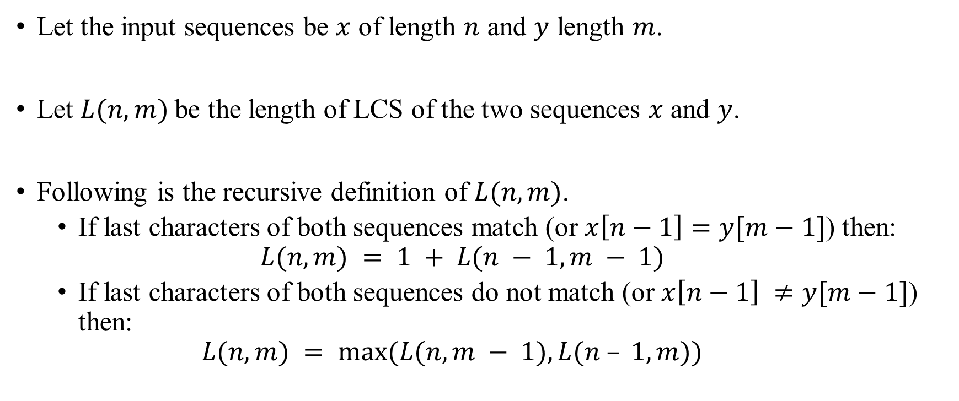
Longest Common Subsequence Algorithm
Let the input sequences be $x$ of length $n$ and $y$ length $m$.
Let $L(n, m)$be the length of LCS of the two sequences $x$ and $y$.
Following is the recursive definition of $L(n, m)$.
If last characters of both sequences match (or $x\left[n−1\right]=y[m−1]$) then: $L(n, m) = 1 + L(n − 1, m − 1)$
If last characters of both sequences do not match (or $x\left[n−1\right] ≠y[m−1]$) then: $L(n, m) = max⁡(L(n, m − 1), L(n – 1, m))$

Slide 47

Longest Common Subsequence Example
Consider the input strings $“AGGTAB”$and $“GXTXAYB”$.
Last characters match for the strings. So length of LCS can be written as: $L(“AGGTAB”, “GXTXAYB”) = 1 + L(“AGGTA”, “GXTXAY”)$

Slide 48
Longest Common Subsequence Example
 | A | G | G | T | A | B
G | 0 | 1 | 1 | 0 | 0 | 0
C | 0
T | 0
X | 0
A | 1
Y | 0
B | 0

Slide 49
Longest Common Subsequence Example
 | A | G | G | T | A | B
G | 0 | 1 | 1 | 0 | 0 | 0
C | 0 | 1 | 1 | 1 | 1 | 1
T | 0
X | 0
A | 1
Y | 0
B | 0

Slide 50
Longest Common Subsequence Example
 | A | G | G | T | A | B
G | 0 | 1 | 1 | 0 | 0 | 0
C | 0 | 1 | 1 | 1 | 1 | 1
T | 0 | 1 | 1 | 2 | 2 | 2
X | 0
A | 1
Y | 0
B | 0

Slide 51
Longest Common Subsequence Example
 | A | G | G | T | A | B
G | 0 | 1 | 1 | 0 | 0 | 0
C | 0 | 1 | 1 | 1 | 1 | 1
T | 0 | 1 | 1 | 2 | 2 | 2
X | 0 | 1 | 1 | 2 | 2 | 2
A | 1
Y | 0
B | 0

Slide 52
Longest Common Subsequence Example
 | A | G | G | T | A | B
G | 0 | 1 | 1 | 0 | 0 | 0
C | 0 | 1 | 1 | 1 | 1 | 1
T | 0 | 1 | 1 | 2 | 2 | 2
X | 0 | 1 | 1 | 2 | 2 | 2
A | 1 | 1 | 1 | 2 | 3 | 3
Y | 0
B | 0

Slide 53
Longest Common Subsequence Example
 | A | G | G | T | A | B
G | 0 | 1 | 1 | 0 | 0 | 0
C | 0 | 1 | 1 | 1 | 1 | 1
T | 0 | 1 | 1 | 2 | 2 | 2
X | 0 | 1 | 1 | 2 | 2 | 2
A | 1 | 1 | 1 | 2 | 3 | 3
Y | 0 | 1 | 1 | 2 | 3 | 3
B | 0

Slide 54
Longest Common Subsequence Example
 | A | G | G | T | A | B
G | 0 | 1 | 1 | 0 | 0 | 0
C | 0 | 1 | 1 | 1 | 1 | 1
T | 0 | 1 | 1 | 2 | 2 | 2
X | 0 | 1 | 1 | 2 | 2 | 2
A | 1 | 1 | 1 | 2 | 3 | 3
Y | 0 | 1 | 1 | 2 | 3 | 3
B | 0 | 1 | 1 | 2 | 3 | 4
So answer in this case is 4.

Slide 55
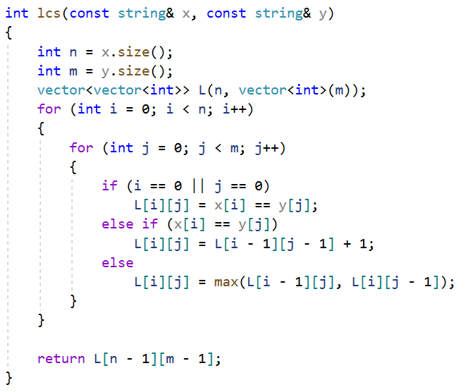
Longest Common Subsequence

Slide 56
Longest Common Subsequence Subsequence reconstruction
Restoring a subsequence can be performed as it was done in the longest increasing subsequence.

